Slide 1
MEDICINE TRACKER AND NOTIFICATION APPLICATION
TEAMMATES:
Arikela Srija (2451-20-737-039)
Praneeth Reddy (2451-20-737-045)
Ajay Reddy(2451-20-737-049)
Under the Guidance of :
P.Sita Sowjanya
Asst.Professor, ITD

Slide 2
ABSTRACT:
Maintaining good health is crucial in our busy and stressful world. However, medication adherence has emerged as a serious issue, as non-adherence can negatively impact patients and increase medical costs. To help with this, our Medicine Tracker and Notification Application allows users to easily track their medication intake and receive timely reminders. The users can add and update their medication details and timing. Notifications through alarm are sent when the medication quantity is low or when it's time to take the next dose. With this system, users can improve their medication adherence and ultimately support their overall health and well-being. With the ability to update medication timing and view their consumption, users can easily maintain a timetable and stay on track with their medication schedule. Ultimately, our system is a valuable tool for promoting good health and well-being.

Slide 3
Introduction:
In today's fast-paced and stressful world, maintaining good health is more important than ever.
However, the challenge of medication adherence is a serious concern that impacts patients and increases medical costs.
Our Medicine Tracker and Notification Application offers a user-friendly platform that allows you to effortlessly track your medication intake and receive timely reminders.
With our system, you can easily add, update, and view your medication details and timing, making it simple to maintain a well-organized timetable.
With our Medicine Tracker and Notification Application, you'll experience improved medication adherence, leading to better health outcomes and reduced medical costs.

Slide 4
Problem Statement:
Medication non-adherence has become a serious issue that negatively affects patients and raises medical costs.

Slide 5
Societal Need:
Many individuals, particularly those with chronic conditions, need to take multiple medications on a regular schedule. Medicine reminders help individuals stay on track with their prescribed medication regimens, improving treatment effectiveness and preventing negative health outcomes.
Older adults may experience cognitive decline or physical limitations that make it challenging to remember and manage their medications. Reminders can assist them in maintaining their independence and managing their health effectively.
Chronic diseases like diabetes, hypertension, and asthma often require long-term management.

Slide 6
Literature Survey:
Name | Year | Authors Name | Algorithms/ Techniques used | Advantages | Limitations
Android Based Application to Ensure Medical Adherence | June,2021 | Anushka Prashant Amte, Bryan Francis, Elisha Halona Edwin Gras, Sini Anna Reji. | The software stack used for application development was the Flutter SDK and the Dart programming language. For the backend, Firebase and its services such as Realtime Database, Storage and Authentication are used. | All medications and their images along with the time of them to be taken are stored and a registered in a database. Through the mobile phone camera, the application can click photos of each medication to help the users to differentiate between different medication by its shape or color. | It does not provide real-life images of the medicine nor the instructions as to how the medicine is to consumed.
Mobile Application for Medicine Reminder | 2021 | Ms. S. A. Patil , Ms. Monika Bhanuse , Ms. Snehal Mali , Ms. Vishaka Swami | The algorithms used are Markov chains for statistical pattern notification, Natural language generation and Rule based systems for for remainders and analyze structured data | With doctors overseeing medication intake, precision is guaranteed and potential dangers are preemptively addressed based on patients' health conditions. This proactive approach ensures accurate treatment and minimizes risks. | Patients lack awareness of medication intake; SMS and emails may be ignored. Monitoring multiple patients' data poses challenges for doctors.

Slide 7
Name | Year | Authors | Algorithms/ Techniques used | Advantages | Limitations
Med - X, Medicine Reminder App | 2021 | Prafful Naikode, Poojal Pithwa, Lakshitha Landge | Threshold alarm algorithm sets off alerts when a certain value exceeds or falls below a predefined threshold, ensuring timely notifications for critical events or conditions. It helps maintain safety and prompt action in real-time monitoring systems. | This System has both Alarm and Notification. Doctor prescription is stored in MongoDB | Special hardware device is used as alarm system is used.
Med-Tracker: Android app for medicine tracking | 2020 | Shrutika Deokar, Sourabh Khandake, Shubam Ture, Deepti Lawand | This framework utilizes NLP algorithm( Key Extraction) and OCR(Optical Character Recognition) is an algorithm used which converts image of text into machine readable text format. | Firebase is a Backend-as-a-Service, permits user with all types of authentication. OCR makes easier to store data directly from text irrespective of platforms. | If at all the text is not clear in the prescription image, the OCR may recognize and store the wrong data.

Slide 8
Name | Year | Authors | Algorithms/ Techniques used | Advantages | Limitations
Medical Care Reminder for Infants Using Android Application | June,2017 | Abdulrahman Alkandari, Dana Aladem, Somalia Asaad, Samer Moein | Reminder Prediction Algorithm(RPA) | Any extra information or instructions which user wants to add can be written in the note section. This application targets the children, the vaccination dates, names and process can be stored and encourage parents to learn how to deal with side effects of vaccination. The instruction service is dedicated to give specific awareness to the users. | Alarm should be set by the users itself. If they forget to set the alarms they will not receive the reminders.

Slide 9
Existing System:
Multiple Medication Reminder Systems have been developed on different platforms. A lot of these systems require special hardware devices to remind the patient about the medicine in-take timings. Purchasing new hardware devices becomes costly and more time and money consuming.
Drawbacks:
User forgetfulness
Complexity and usability
Cost

Slide 10
Hardware and Software requirements:
Hardware requirements
● Processor : 3.0 GHz Intel(R) Pentium (R) processor
● Hard Disk : 80GB
● RAM : 4.0GB
●Flash Disk : 4.0GB
Software requirements
● Operating System : Windows 7/8/10, Android
● IDE : Android Studio
● Technology : Java

Slide 11
Proposed System:
The proposed medication reminder application that utilizes existing smartphone technology. The application will serve as the central hub for medication reminders and management. Users will give input of their medication details into the app. This includes the medication name, dosage, frequency, preferred reminder time and type of medicine. The mobile app will push notifications through to the user's smartphone at the designated reminder times. The reminders will include the medication name and dosage. Designing the application with a user-friendly interface that is easy to navigate, making it accessible to users of all age groups and technical backgrounds.

Slide 12
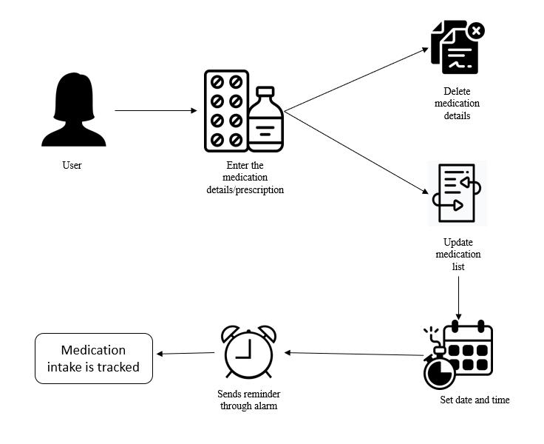
Proposed System Architecture:

Slide 13
UML Diagrams
Use case Diagram:
A use case diagram in the Unified Modeling Language (UML) is a type of behavioral diagram defined by and created from a Use-case analysis. Its purpose is to present a graphical overview of the functionality provided by a system in terms of actors, their goals (represented as use cases), and any dependencies between those use cases.

Slide 14
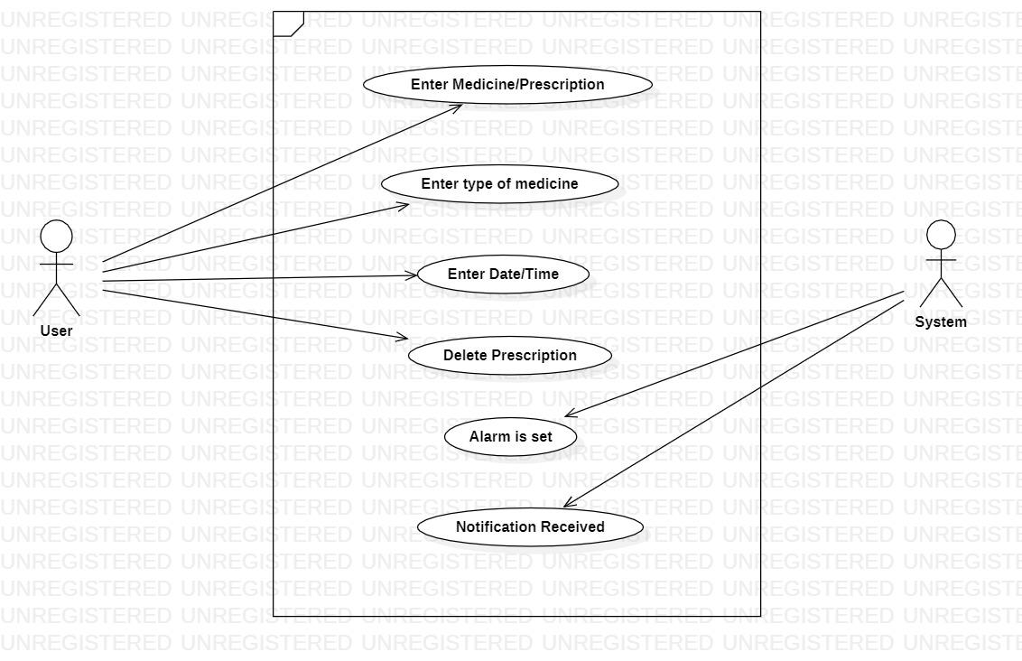

Slide 15
Activity Diagram:
Activity diagrams are graphical representations of workflows of stepwise activities and actions with support for choice, iteration and concurrency. In the Unified Modelling Language, activity diagrams can be used to describe the business and operational step-by-step workflows of components in a system. An activity diagram shows the overall flow of control.

Slide 16
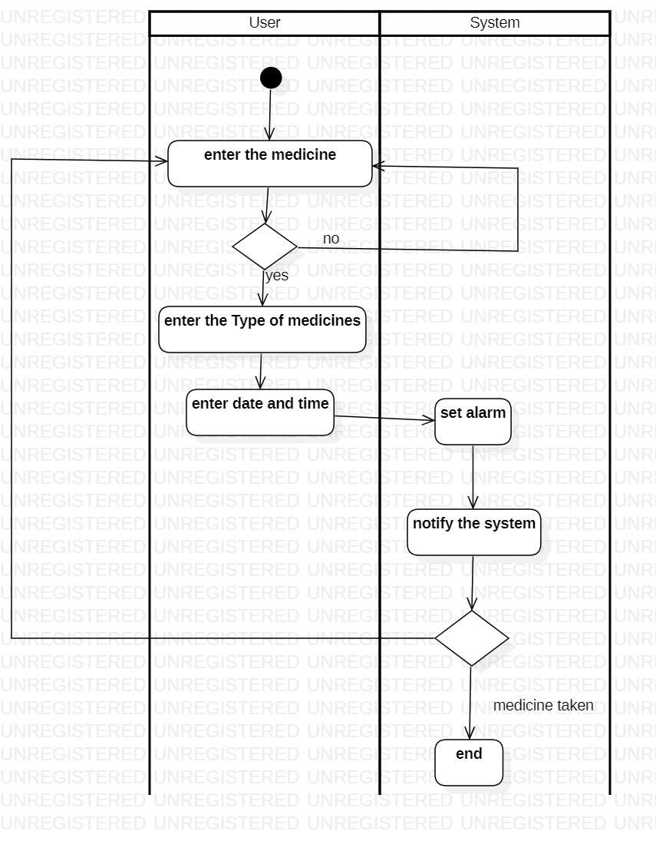

Slide 17
Class Diagram:
In software engineering, a class diagram in the Unified Modeling Language (UML) is a type of static structure diagram that describes the structure of a system by showing the system's classes, their attributes, operations (or methods), and the relationships among the classes. It explains which class contains which information.

Slide 18
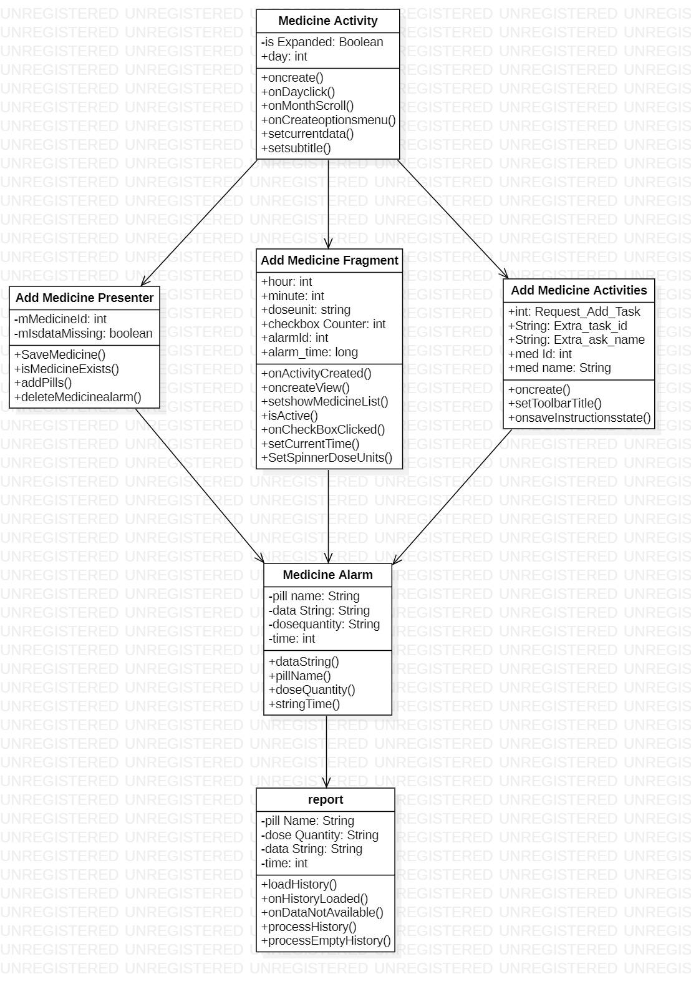

Slide 19
Implementation:
Project setup: Install Android Studio and download SDK version 30.02.4.1, gradle version 7.4.1.
Design the application: Create a visually appealing design for the application using Java and XML. Consider incorporating medicine theme into the layout,colors and images.
Homepage: Create a homepage that consists of calender and medication adding option.
After adding medicines or prescription with medicine name,medicine days, reminder time, dose quantity, type of medicine. The entered data is tracked.
When it’s time for medicine intake the alarm is triggered.
When alarm is triggered the a message pops up with check box.
If the medicine is taken yes check box is ticked or else no.
Based on the input medicine history is tracked.

Slide 20
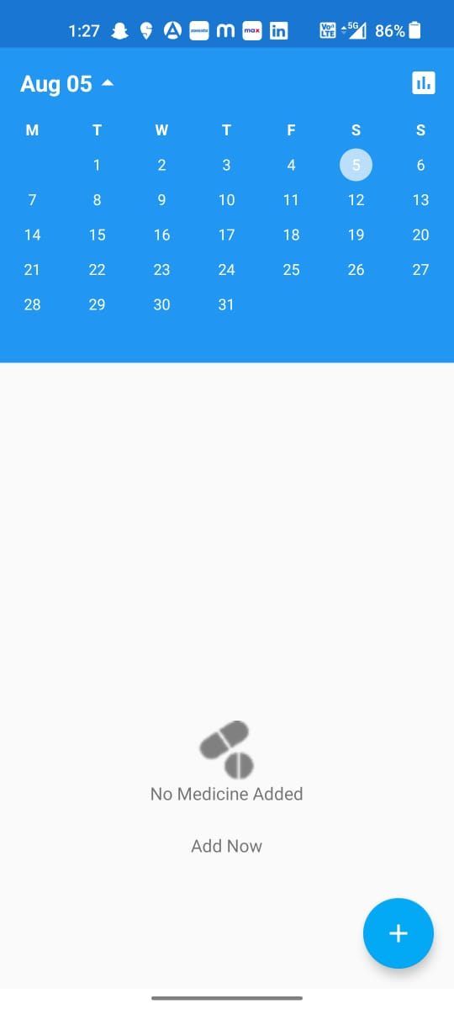
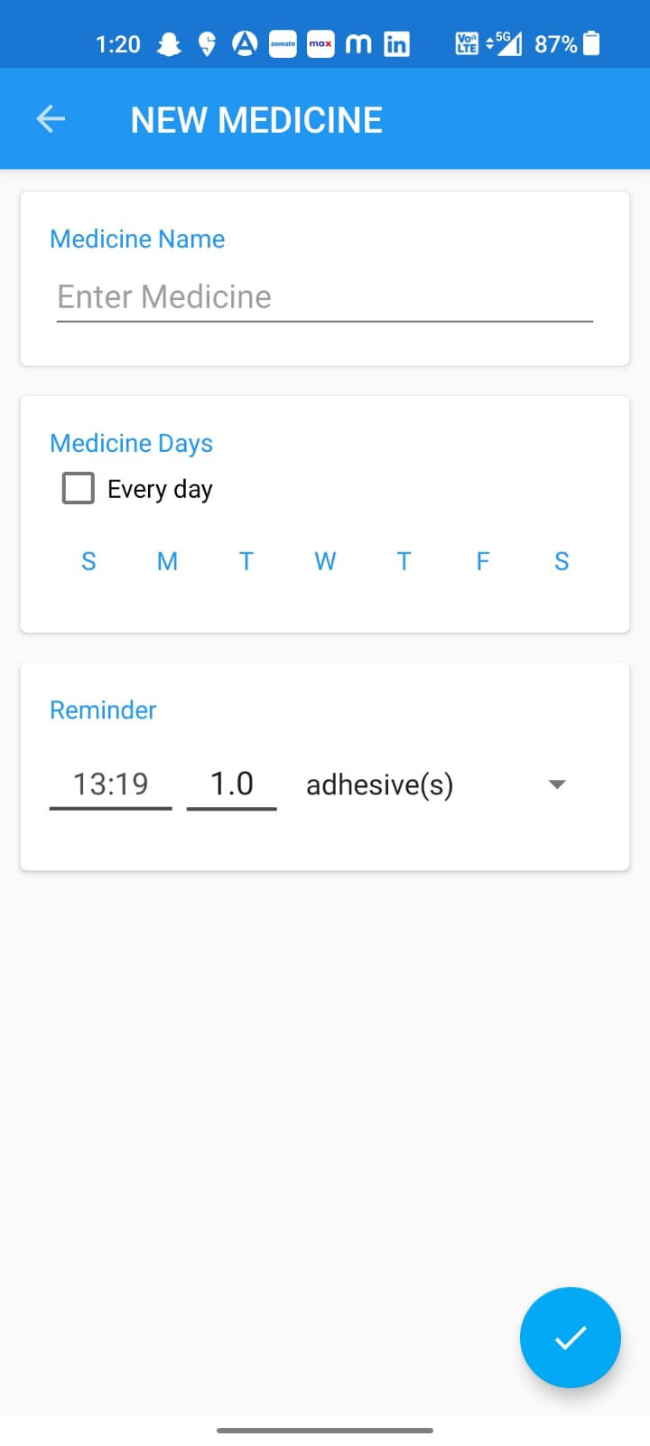
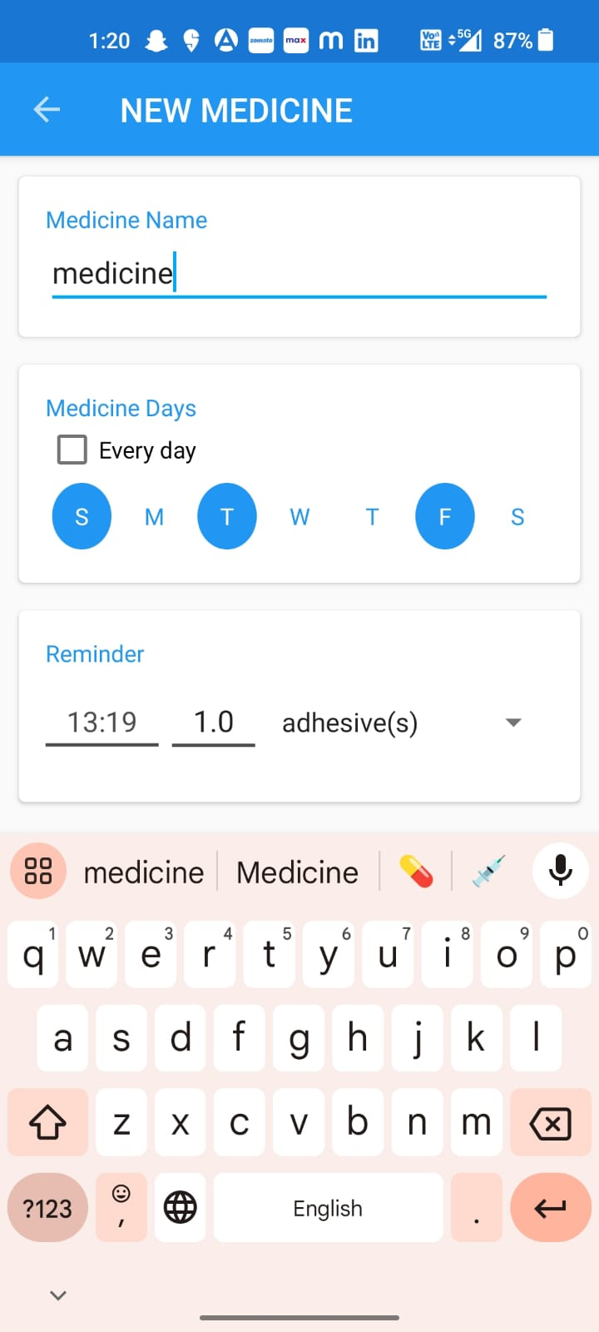
Review Analysis:

Slide 21
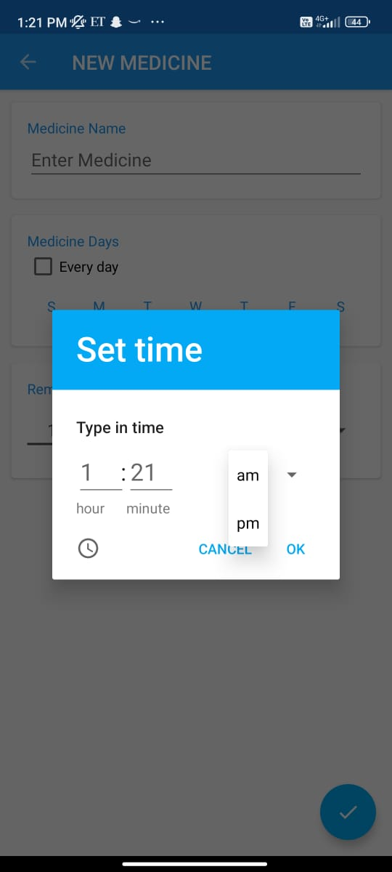
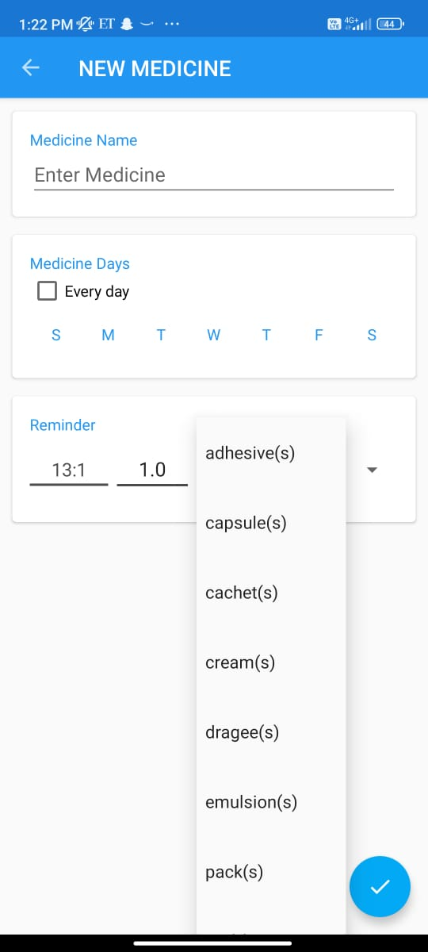
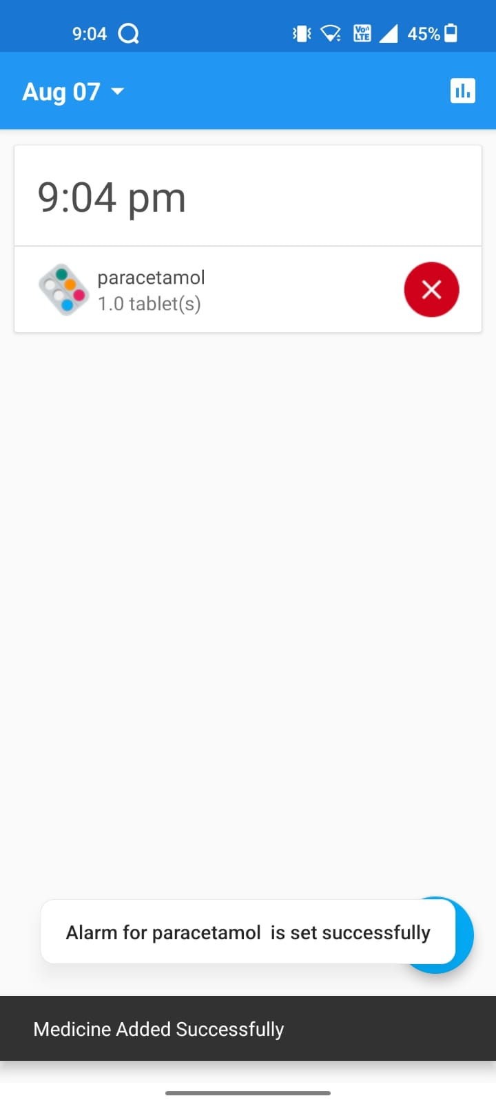

Slide 22
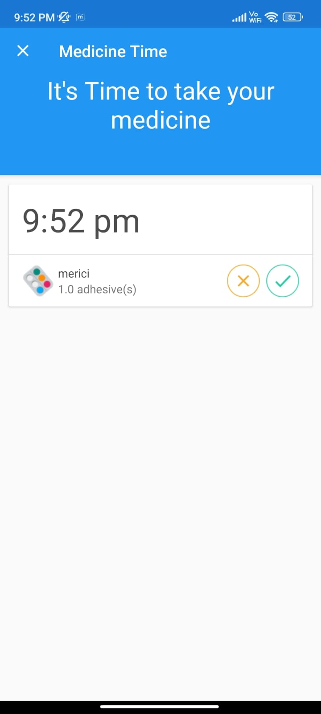
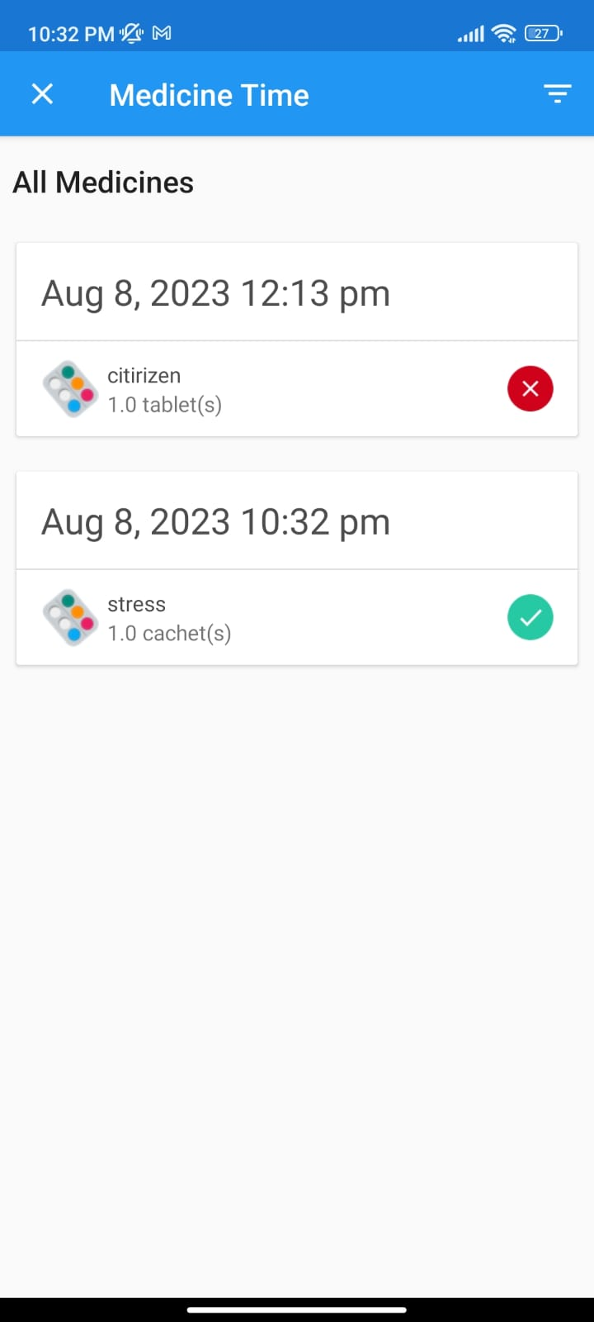

Slide 23
References:
Alfredo V. Atienza, Lorissa Joana E. Buenas, Froilan G. Destreza, "Towards Personalized Medication Management: A Novel Approach to Medication Reminder Using Wearable Sensors and IoT", 2023 IEEE International Conference on Automatic Control and Intelligent Systems (I2CACIS), pp.167-172, 2023.
Pradnya Mhatre, Rasika Patil, "IoT Based Pill Reminder System", International Journal of Advanced Research in Science, Communication and Technology, pp.536, 2022.
M. Neela Harish, "Patient Medicine Reminder System", Advances in Materials Research, vol.5, pp.73, 2021.
Dan O. Oketch, Topside E. Mathonsi, "Smart Task Reminder Model for People with Mild Dementia at Home", 2021 International Conference on Computational Science and Computational Intelligence (CSCI), pp.1236-1240, 2021.
Abhishek Madankar, Akhilesh Agrawal, Vedant Yede, "IoT based Advance Pill Reminder System for Distinct Patients", 2021 Fifth International Conference on I-SMAC (IoT in Social, Mobile, Analytics and Cloud) (I-SMAC), pp.161-165, 2021.

Slide 24
Conclusion:
In conclusion, ensuring proper medication adherence is vital for maintaining optimal health and managing medical conditions effectively. Our Medicine Tracker and Notification Application offer a robust solution to the challenge of medication non-adherence. By seamlessly integrating technology, data management, and user-friendly interfaces, we empower individuals to take control of their medication routines. Through automated tracking and timely reminders, users can establish consistent habits, reduce the risk of missed doses, and improve treatment outcomes. This system not only simplifies the process of medication management but also contributes to enhanced overall well-being and a higher quality of life. As we continue to advance in the realm of healthcare technology, our Medicine Tracker and Notification System stand as an example of how innovative solutions can address critical health-related issues and foster a healthier society.

Slide 25
ANY QUERIES?

Slide 26
THANK YOU…

